Slide 1
WHAT IS
ARTIFICIAL INTELLIGENCE?

Slide 2
General Goal
Artificial Intelligence is an attempt to understand and build intelligent devices.
It covers activities such as:
  perception
  understanding
  reasoning
  prediction
  representing knowledge
The field is relatively young (name was coined in 1956).
Exciting applications:
  playing chess
  proving theorems
  writing poetry
  medical diagnosis
  robotics

Slide 3
What is AI
Strong AI and Weak AI
AI domains
AI methods
AI and other disciplines
Timeline

Slide 4
Strong AI
Create a robot which is autonomous, thinks for itself, makes its own decisions, can deliberate about its own thoughts, can learn and adapt to new situations and can communicate with humans through the use of language.

Slide 5
Weak AI
To build a computer program that simulates a particular intelligent activity, e.g. playing chess.

Slide 6
Some AI Definitions
"The branch of computer science that is concerned with the automation of intelligent behavior.”
" The science of making machines do things that would require intelligence if done by men.”
"The study of computations that make it possible to perceive, reason, and act“.

Slide 7
No single universal definition currently exists for artificial intelligence.
Some accepted definitions:
“The effort to make computers think…”
“The study of the design of intelligent agents…”
“The study of mental faculties through …computational models.”
Dilemma: acting humanly vs acting rationally.
hypothesis and experiments.
mathematics and engineering.

Slide 8
Some Important Questions
How do we define human behavioral and thinking patterns ?
How do we define a rational behavior ?
What should be the difference between an ordinary program (say a sorting program) and an AI program ?
What is the essence of intelligent behavior ?

Slide 9

Acting Humanly
The Turing Test.
In 1950 Alan Turing proposed an interesting test to decide if a machine qualifies
as intelligent or not: hide a computer and a person from an interrogator; the computer
is considered intelligent if the interrogator cannot decide if the answers are provided
by the human or the machine.
Computer
Interrogator
Person

Slide 10
Acting Humanly
To pass the Turing test, a computer needs to display the following abilities:
Natural language processing
Knowledge representation
Automated Reasoning
Machine Learning
Computer Vision
Robotics
Related field: Cognitive Science
Goal: construct theories of how the human mind works through computer models.

Slide 11
Acting Rationally
Old View.
  Originally dominated by the “logic” approach.
  The goal is to build intelligent agents using mathematical logic.
  Disadvantage: hard to deal with uncertainty.
Modern View.
  More current view is to build rational agents.
  Agents are autonomous, perceive, adapt, change goals and deal
  with uncertainty.
  It is easier to evaluate and more general.
The focus of this course is on Rational Agents.

Slide 12
Specifics of AI problems
Require both procedural and declarative knowledge
Require reasoning abilities
Require planning
Require learning abilities

Slide 13
Intelligent Agents
Features | Topics
Goal - motivated behavior | State space search
Decision making | Logical systems; reasoning patterns
Knowledge-based behavior | Knowledge representation Information Data Knowledge
Adaptive behavior | Machine learning
Interaction and communication | Vision, Pattern recognition Natural Language Processing
Physical activity | Robotics

Slide 14
AI methods, problems, applications
Paradigms: Symbolic; Connectionists
Methods: Knowledge Representation, Logic, Search
Problems: Planning and Decision Making, Pattern Recognition, Machine Learning
Applications: Intelligent agents, Expert systems, Game playing, Natural Language Processing, Robotics

Slide 15
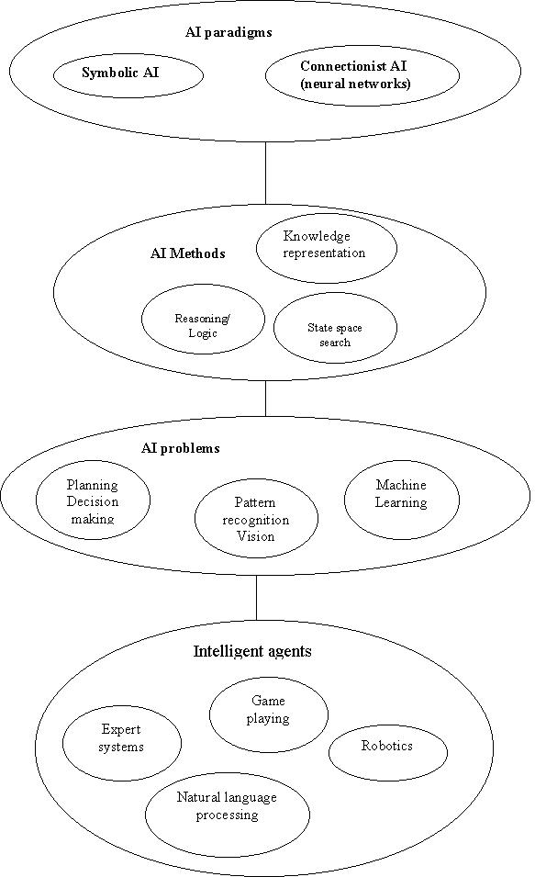

Slide 16
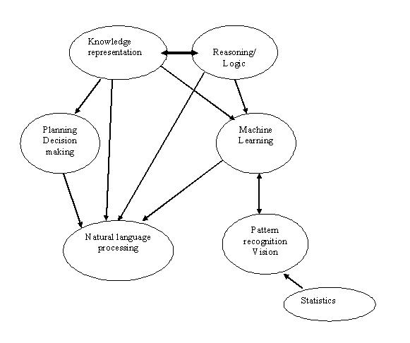

Slide 17
Example
A farmer has to move a goat, a cabbage and a wolf from one side of a river to the other side using a small boat. The boat can carry only the farmer and one more object (either the goat, or the cabbage, or the wolf).
If the farmer leaves the goat with the wolf alone, the wolf would kill the goat.
If the goat is alone with the cabbage, it will eat the cabbage.
How can the farmer move all his property safely to the other side of the river?

Slide 18
Solution
Identify the initial and the target states
Choose appropriate representation of the states
Decide on operators to change the states.
Identify restrictions: are all operators applicable to all states?
Decide on how the cost of the solution would be measured
Solve the problem

Slide 19
AI and other disciplines
Philosophy
Psychology/ Cognitive psychology / Cognitive Science
Mathematics
Computer Science
Computer Engineering
Computational Linguistics
Biology and Neurology

Slide 20
Connection with other disciplines
Do we follow rules to draw conclusions?
How does mind arise from a physical brain?
How to represent knowledge?
Philosophy.
Formal rules to draw conclusions (logic)
What can be computed?
  Incompleteness theorem
  Intractability
  NP-completeness
  Probability (Bayes rule)
Mathematics.

Slide 21
Connection with other disciplines
Decision Theory
Make decision to maximize payoff
Probability and Utility theories.
Sometimes playing random is best.
Economics.
Study of the brain.
Structure of neurons
Cognitive processes
Compare chips to neurons in terms of processing.
Neuroscience.

Slide 22
Connection with other disciplines
How do we think and act?
Cognitive science
Psychology.
How do we make computers more efficient?
Performance doubles every approx. 18 months
Computer Engineering.
Control Theory.
Design systems that maximize an
objective function over time.
Linguistics.
Connection between language
and thought.

Slide 23
Data Mining
Knowledge Discovery and Data Mining
Selection
Preprocessing
Transformation
Data
Target Data
Preprocessed
Data
Transformed
Data
Interpretation &
Evaluation
Data
Mining
Patterns
Knowledge

Slide 24
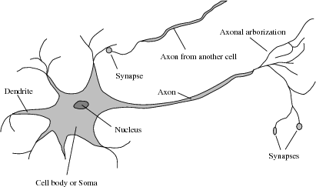
Origin

Slide 25
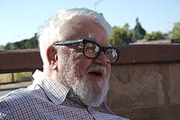
John McCarthy
Born in Boston 1927
Became full professor at Stanford in 1962
(until his retirement in 2000).
Coined the term Artificial Intelligence (AI)
Developed the language LISP
Supported Mathematic Logic for AI

Slide 26
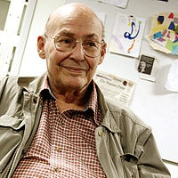
Marvin Minsky
Born in New York 1927
MIT Faculty since 1958
Winner of the Turing Award in 1969
Wrote the book “Perceptrons”.
Member of the National Academy of Engineering and National Academy of Sciences.

Slide 27
Timeline of AI
1943___Warren McCulloch and Walter Pitts: a model of connected artificial neurons
1949___Donald Hebb developed Hebbian Learning
1956___Dartmouth workshop Alan Turing, John McCarthy, Marvin Minsky, Allen Newell
1958___LISP by McCarthy

Slide 28
Timeline of AI
1965__ELIZA :Weizenbaum, a program that acts as a psychoterapist.
Work on machine translation - unsuccessful.
1966__Funding for AI stopped.
Difficulties: Lack of knowledge about world. The scale problem - easy to solve toy problems, very difficult to solve real world problems

Slide 29
Timeline of AI
1969-1979 __ Knowledge -based systems
1972 __ Prolog, created by Alain Colmerauer
1975 __ Frames: a knowledge representation scheme, developed by Marvin Minsky.

Slide 30
Timeline of AI
SHRDLU by Terry Winograd - understanding natural language in the block world.
DENDRAL - inferring molecular structure from the information provided by a mass spectrometer. Developed by Edward Feigenbaum, Bruce G. Buchanan, and others.

Slide 31
Timeline of AI
MYCIN – a rule-based system for knowledge representation and inference in the domain of medical diagnosis and therapy… diagnose blood infections .
(The first expert system) .

Slide 32
Timeline of AI
1980 __ R1 - first commercial ES - McDermott, configures orders for new computer systems.
1981 __ Fifth generation project in Japan.
Mid 80's __ Neural Networks

Slide 33
Timeline of AI
1990’s __ Major advances in Machine learning, Natural language processing, multi-agent systems, robotics
AI is in the driver’s seat i.e. self-driving cars (Pomerleau, 1993)

Slide 34
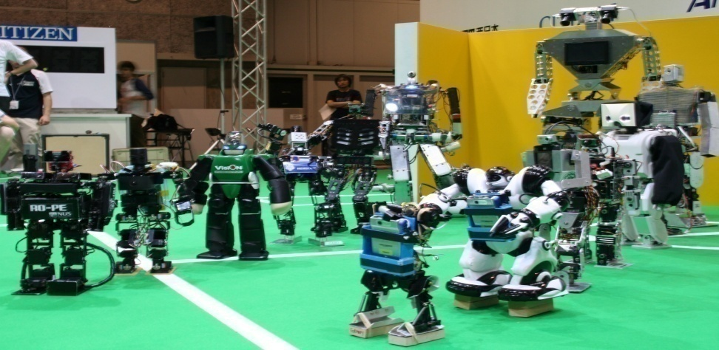
Timeline of AI
2000 __ Robotics:
Humanoid robots - Rodney Brook
Robo-Cup soccer
Humanoid sociable robots
Interactive
robot pets
RoboCup Humanoid League 2006

Slide 35
Advanced Techniques
Autonomous planning and scheduling.
  A remote agent generated high-level goals in space
Game playing
  IBM Deep Blue defeated Garry Kasparov
Autonomous control
  ALVINN: trained to steer a car to follow a lane.
Diagnosis
  Performing at a level of experts in medical diagnosis
Logistic Planning
  Plans generated in hours (rather than weeks)
Robotics
  Surgeons use robots assistants in microsurgery
Language understanding and problem solving

Slide 36
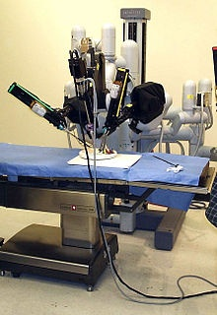
Advanced Techniques
Robotic Surgey
Image copied from Wikipedia, the free encyclopedia.

Slide 37
Thank You

